Slide 1

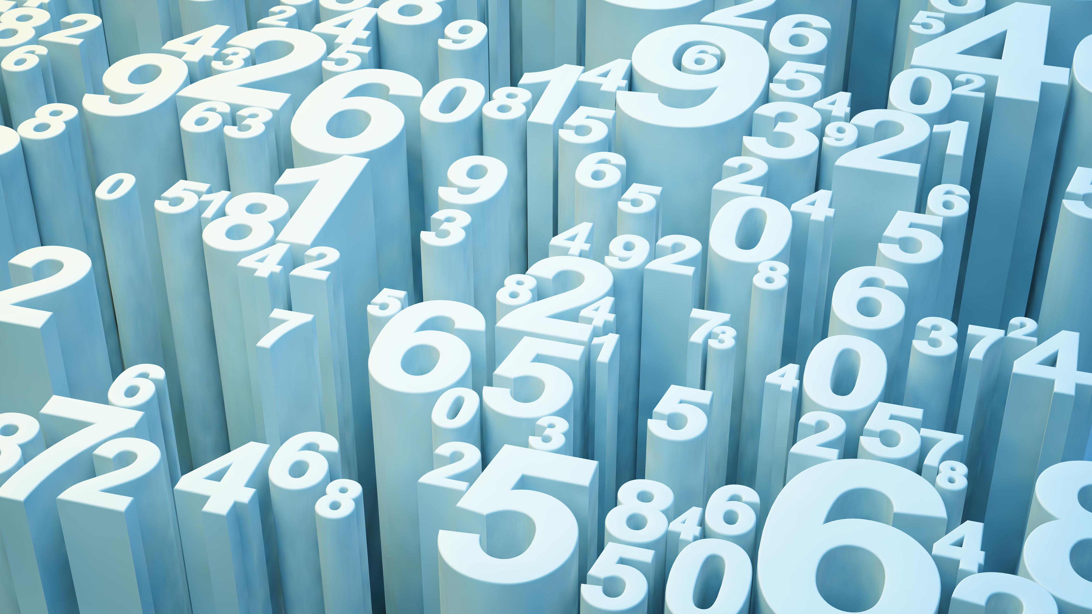
Instagram User Analytics
KUNDA NAVEEN KUMAR DAS

Slide 2
Project description
Instagram user analysis is the process how much their users using Instagram.
By using dataset provided we gonna analyse the dataset and provide the business insights.
The things we gonna find are how many users engaging with Instagram,how many are bots.

Slide 3
Approach
At first, I created a database using mysql with users,photos,follows,likes,tags,comments,photo_tags as tables in that database.
I understood the question which is given by marketing team and the investors.
I analysed the database and gave insights (given below) to the questions according to the data.

Slide 4
Tech-Stack used-MYSQL
I used MYSQL command line client to create a database and to execute the queries to answer the questions provided.

Slide 5
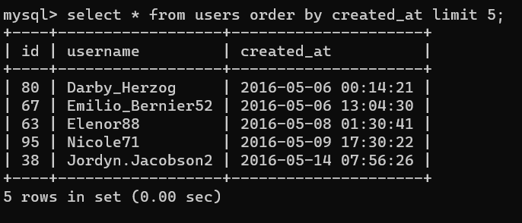
Insights
Rewarding Most Loyal Users
These are the 5 People who have been using the platform for the longest time.

Slide 6
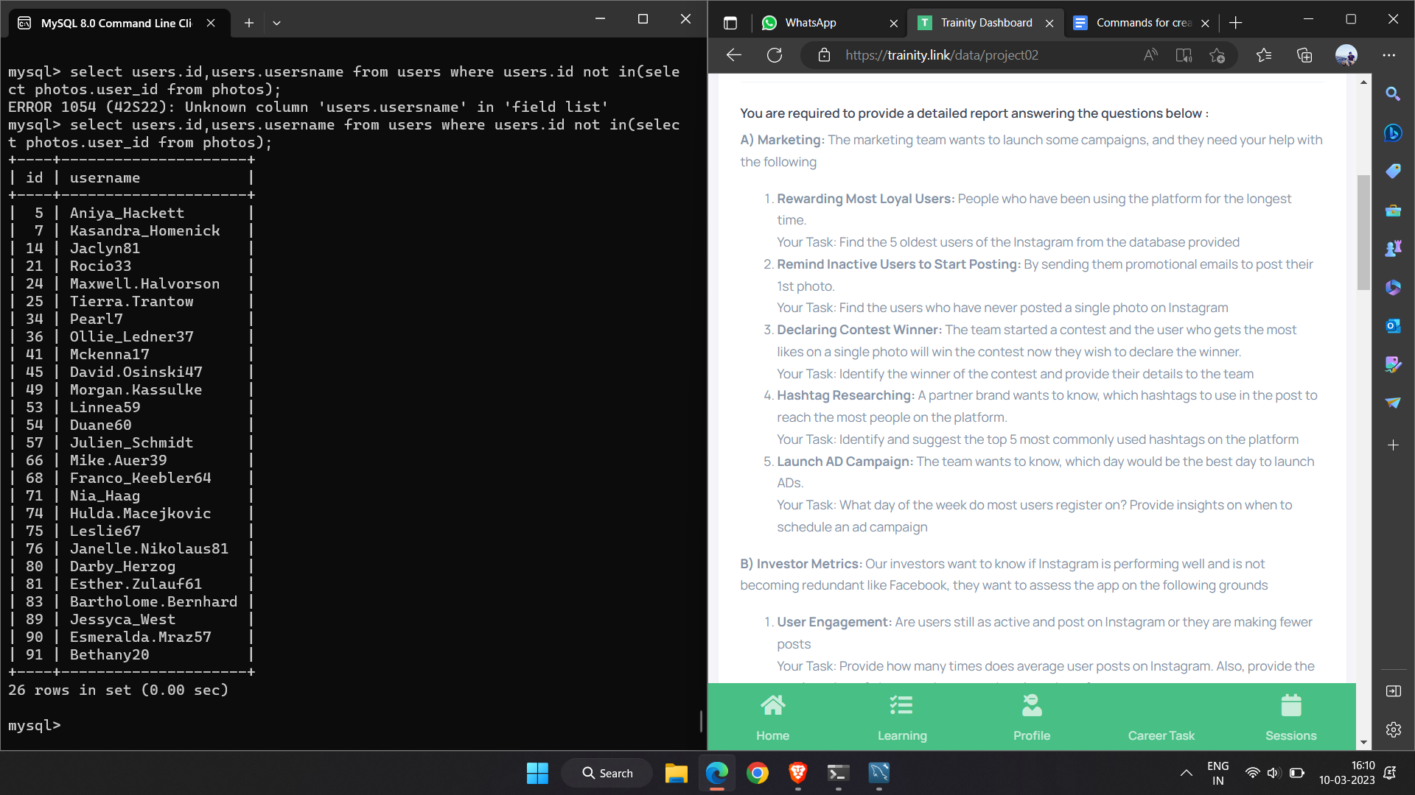
Remind Inactive Users to Start Posting
Mentioned people are
needed of promotional
emails to post their 1st photo on
intagram.

Slide 7
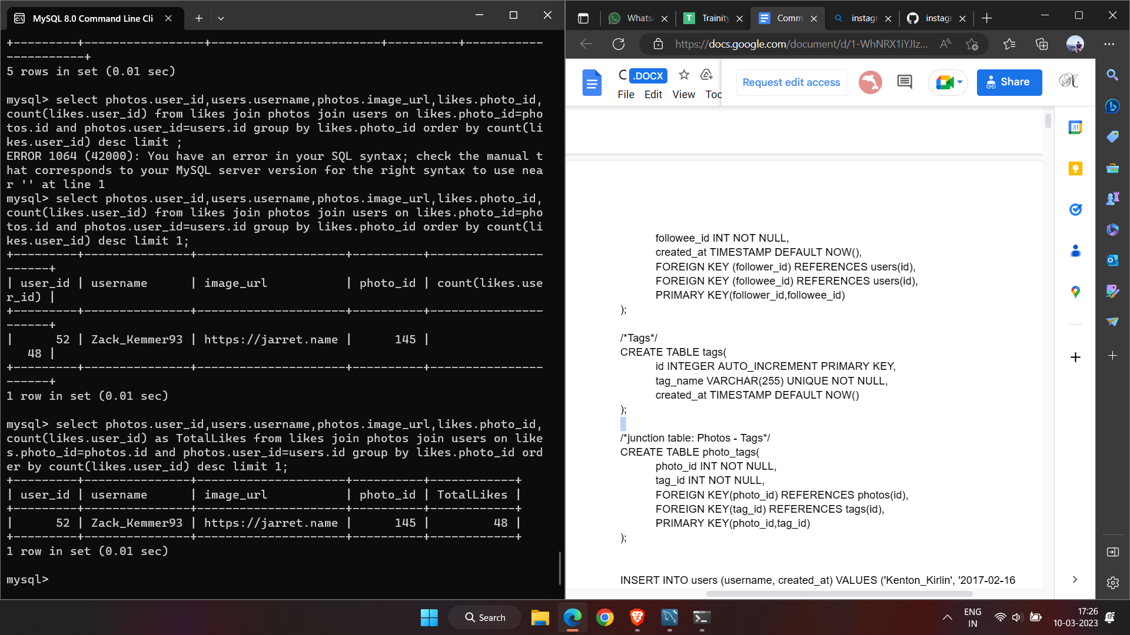
Declaring Contest Winner
The one with most likes on a single photo.

Slide 8
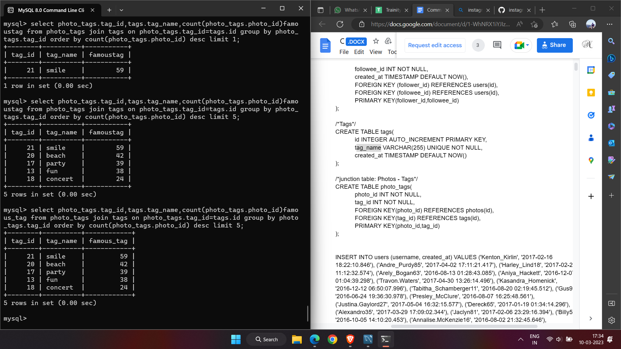
Hashtag Researching
The hashtags that are mostly used.

Slide 9
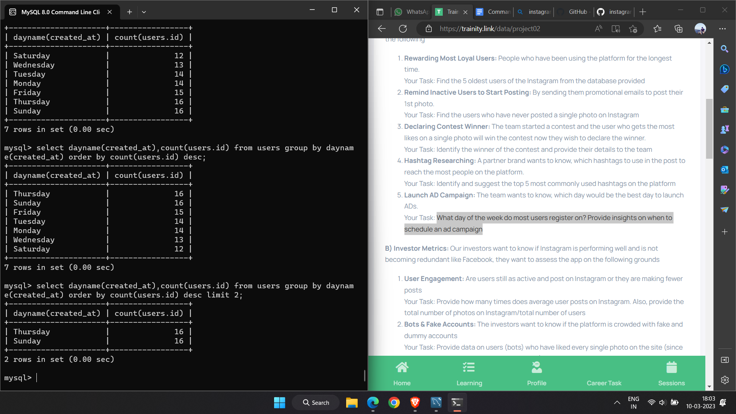
Launch AD Campaign
Best days to launch ads are Sunday and Thursday.

Slide 10
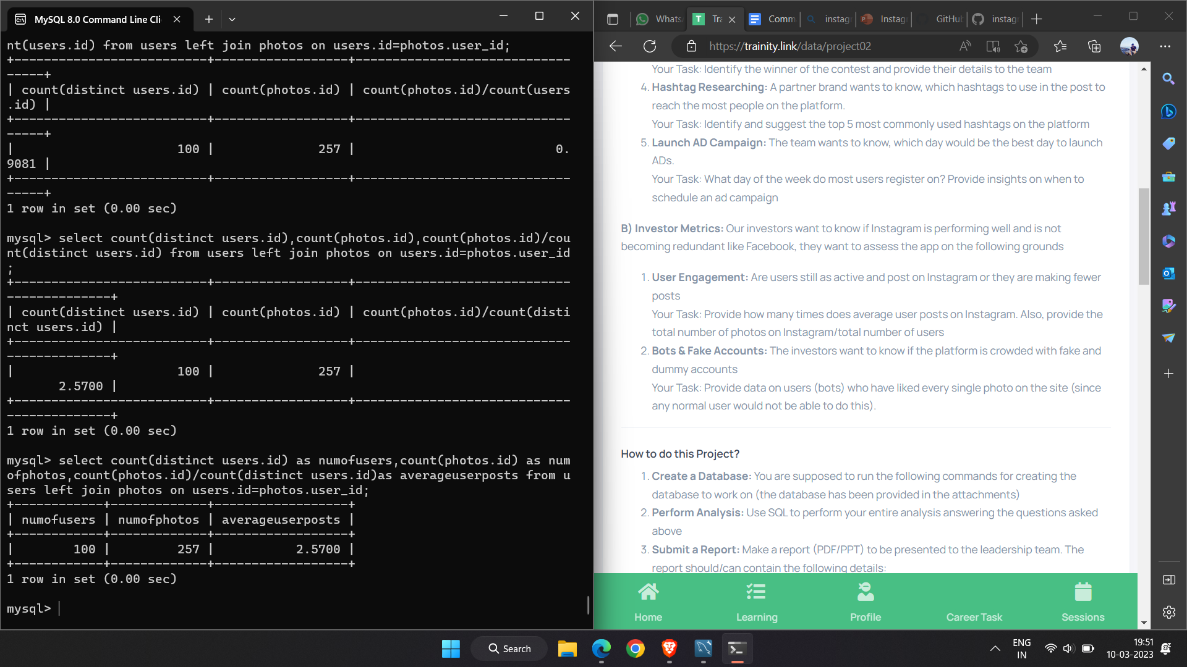
User Engagement
The total number of photos on Instagram/total number of users.

Slide 11
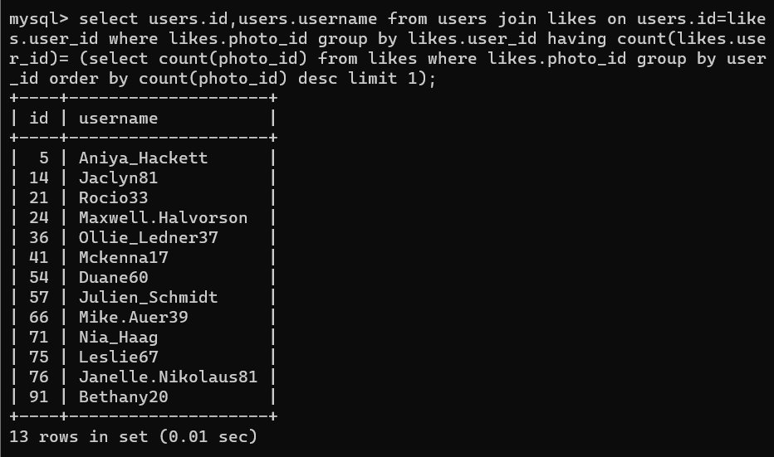
Bots & Fake Accounts
The fake users are :

Slide 12
Result
While making the project,I got the better understanding about SQL queries and how SQL is used in to gain insights in business perspective and also it helped me to solve any problem of this kind.

Slide 13
Thank you!!!

